Slide 1
Rating Prediction of Google Play Store Apps with
Application of Data Mining Techniques

Slide 2
DOMAIN INTRODUCTION
Datamining, also known as text data mining, is the process of transforming unstructured text into a structured format to identify meaningful patterns and new insights.
Text is a one of the most common data types within databases. Depending on the database, this data can be organized as:
Structured data: This data is standardized into a tabular format with numerous rows and columns, making it easier to store and process for analysis and machine learning algorithms. Structured data can include inputs such as names, addresses, and phone numbers.
Unstructured data: This data does not have a predefined data format. It can include text from sources, like social media or product reviews, or rich media formats like, video and audio files.
Semi-structured data: As the name suggests, this data is a blend between structured and unstructured data formats. While it has some organization, it doesn’t have enough structure to meet the requirements of a relational database. Examples of semi-structured data include XML, JSON and HTML files.

Slide 3
ABSTRACT
Nowadays online reviews play a significant role in influencing the decision of consumers. Consumers show their experience and information about quality in their reviews. Online reviews typically consist of qualitative (text format) and quantitative (rating) formats.
In the case of Google Play store fake numeric ratings can play a big role in the success of apps. People tend to believe that a high-star rating may be significantly attached with a good review. However, user star level rating information does not usually match with text format of review.
Despite many efforts to resolve this issue, Google Play Store is still facing this problem. Here, proposes a novel Google App numeric reviews & ratings contradiction prediction framework using Machine Learning approaches.
Star ratings are predicted from text format of reviews after training Machine Learning models.
Experimental results demonstrate that based on actual user reviews the proposed framework significantly predicts unbiased star rating of app.

Slide 4
INTRODUCTION
Machine learning approaches are essential for us to take care of numerous issues. In this paper, we present machine learning models and structures in detail. Machine learning has numerous applications in numerous perspectives and has incredible advancement potential.
It is predictable that machine learning could set up ideal speculations to clarify its exhibitions. In the meantime, its capacities of unsupervised learning will be improved since there is much information on the planet however it isn't relevant to add names to every one of them.
It is additionally anticipated that neural system structures will turn out to be increasingly unpredictable with the goal that they can separate all the more semantically important highlights. In addition, profound learning will consolidate with support adapting better and we can utilize this points of interest to achieve more assignments.

Slide 5
OBJECTIVE
The main objective is to predict the ratings of Google Play Store apps using machine learning Algorithms.
To perform Data Analysis and prediction into the Google Play store application dataset that I have collected from repository.
Using Machine Learning Algorithms, I have tried to discover the relationships among various attributes present in my dataset such as which application is free or paid, about the user reviews, rating of the application.
To enhance the performance of overall prediction result.

Slide 6
EXISTING SYSTEM
In existing system, to find out names of those applications which come on the top of the entire free app with their respective rating.
After analyzing all the attributes of given dataset using hive I have made the prediction on the user reviews of the particular application that which particular review is positive or negative using algorithms.
Calculate the output compare it with actual output and then train the model and adjust the weights to minimize the error using backpropagation this process is performed several times.
Finally by comparing the output after training process with the set range to find out which review is positive or negative.

Slide 7
DISADVANTAGES
Data inconsistency Problems.
Less Efficiency and effective.
Incorrect Prediction Results.

Slide 8
PROPOSED SYSTEM
The proposed model is introduced to overcome all the disadvantages that arise in the existing system. This system will increase the accuracy of the classification results by classifying the data based on the googleplay apps.
The dataset collected from the Google Play store is semi structured or unstructured and contains significant superfluous data (defined as not contributing significantly to the prediction process).
Training a supervised machine learning algorithm requires textual documents to be represented in vectorial form. Apply Machine Learning algorithms to predict app’s rating with Regressors (KNN and Random Forest).
Finally, the Performance of classifiers is evaluated on the accuracy, MAE, RMSE and R2-Score.

Slide 9
ADVANTAGES
High performance.
Provide accurate prediction results.
It avoids data inconsistency.

Slide 10

ARCHITECTURE DIAGRAM
Select and View Dataset
Feature Extraction
Dataset
Classification
Data preprocess
Prediction
Splitting Dataset into Train and Test
Result Generation

Slide 11
FLOW DIAGRAM
Start
Select Dataset
View Data
Data Preprocessing
Classification using ML Algorithm
KNN
Random Forest
Null Value Checking
Prediction
Label Encoding
Accuracy
Performance Evaluation
MAE
Data Visualization
RMSE
R2-Score
Splitting Dataset into Training and Test Dataset

Slide 12
USECASE DIAGRAM
Data Selection
View Dataset
Data Preprocessing
Label Encoding
Data Visualization
Splitting dataset into Train and Test
Feature Selection
ANALYST
Classification
Prediction
Result Generation

Slide 13
CLASS DIAGRAM
DATASET
Select dataset ()
Import dataset ()
View dataset ()
DATA PREPROCESSING
Data Cleaning ()
Tokenize ()
Label Encoding ()
FEATURE EXTRACTION
Dataset Splitting Train and Test
Feature Extraction
RESULT GENERATION
Result Generation ()
CLASSIFICATION
Detection ()
Prediction ()

Slide 14
SEQUENCE DIAGRAM
DATA SELECTION & VIEW
PREPROCESSING
FEATURE EXTRACTION
CLASSIFICATION
RESULT GENERATION
Select path
Data Preprocess
Null Value Check
Splitting Dataset into Training and Test Data
Import Dataset
Classification
Label encoding
Preview Data

Slide 15
ER-DIAGRAM
Null Value Checking
Dataset Splitting
Select Data
Features
Preview Data
Label encoding
Set Path
DATA SELECTION & LOAD
DATA PREPROCESS
FEATURE EXTRACTION
RESULT GENERATION
CLASSIFICATION
FEATURES
Positive
Negative

Slide 16
MODULES
Data Selection and Loading
Data Preprocessing
Exploratory Data Analysis
Splitting Dataset into Train and Test Data
Classification
Performance Evaluation

Slide 17
DATA SELECTION AND LOADING
The data selection is the process of selecting the data for detecting the ratings from the googleplay app dataset.
The dataset which contains the information about the each app (row) has values for catergory, rating, size, and more.
This information is scraped from the Google Play Store. This app information would not be available without it.
The Play Store apps data has enormous potential to drive app-making businesses to success. Actionable insights can be drawn for developers to work on and capture the Android market!

Slide 18
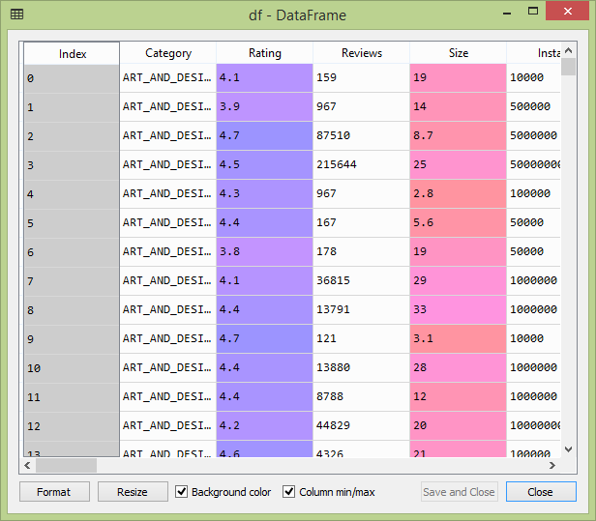

Slide 19
DATA PREPROCESSING
Data pre-processing is the process of removing the unwanted data from the dataset.
Preprocessing is important into transitioning raw data into a more desirable format.
Undergoing the preprocessing process can help with completeness and compellability. For instance, you'll see if certain values were recorded or not.
Also, you'll see how trustable the info is. It could also help with finding how consistent the values are.
We need preprocessing because most real-world data are dirty.
Data can be noisy i.e. the data can contain outliers or simply errors generally. Data can also be incomplete i.e. there can be some missing values.

Slide 20
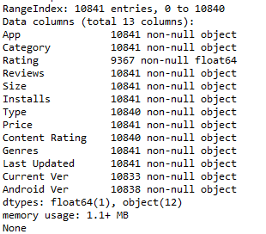
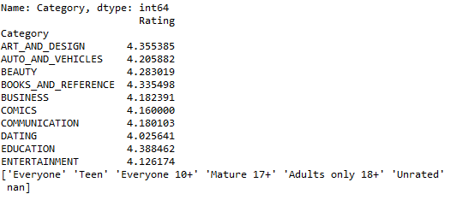

Slide 21
EXPLORATORY DATA ANALYSIS
Exploratory data analysis is an approach of analyzing data sets to summarize their main characteristics, often using statistical graphics and other data visualization methods.
A statistical model can be used or not, but primarily EDA is for seeing what the data can tell us beyond the formal modeling or hypothesis testing task.
The objectives of EDA are to:
Suggest hypotheses about the causes of observed phenomena
Assess assumptions on which statistical inference will be based
Support the selection of appropriate statistical tools and techniques
Provide a basis for further data collection through surveys or experiments

Slide 22
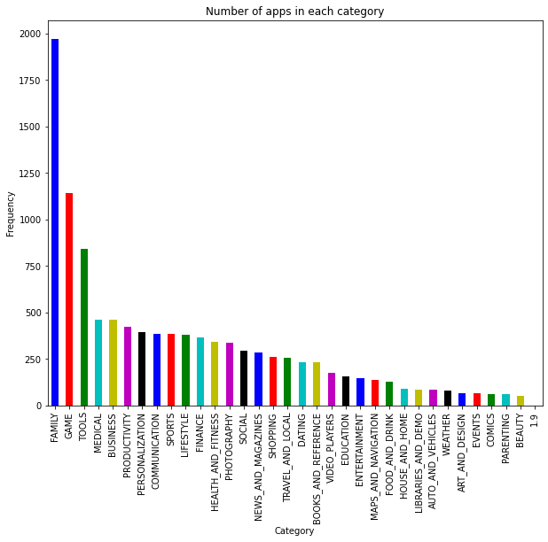
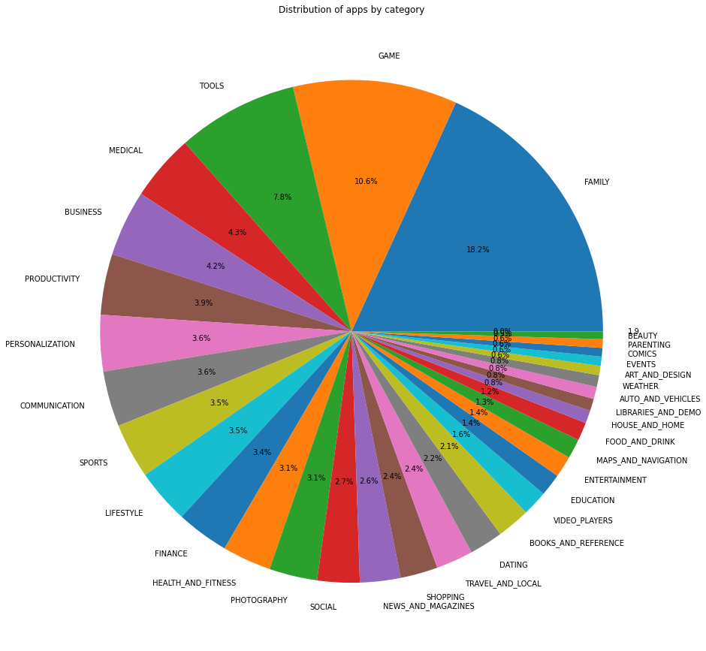

Slide 23
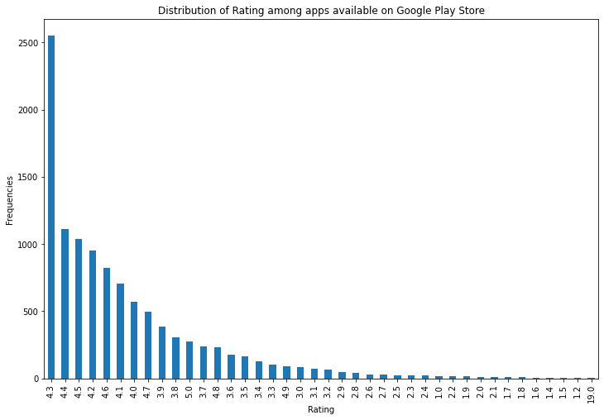
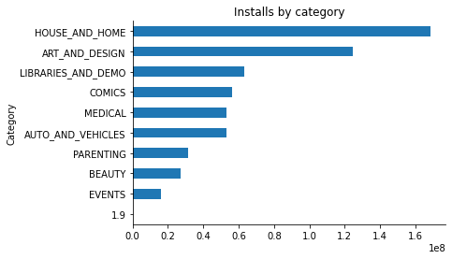
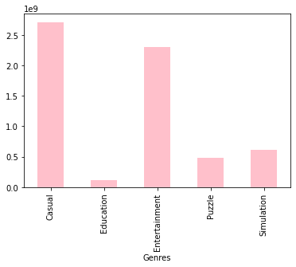
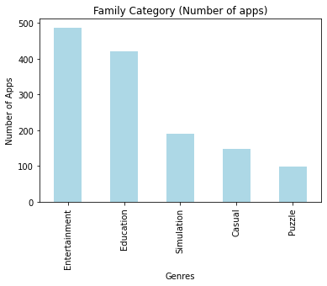

Slide 24
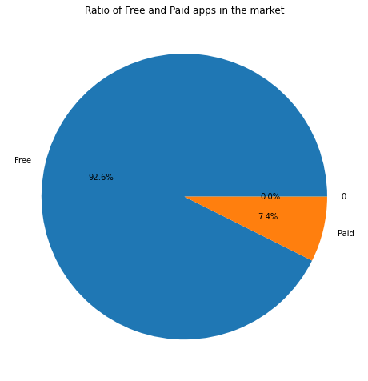
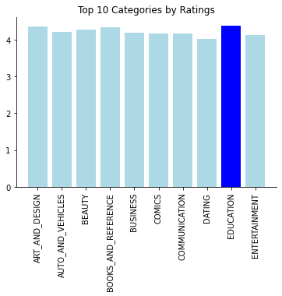

Slide 25
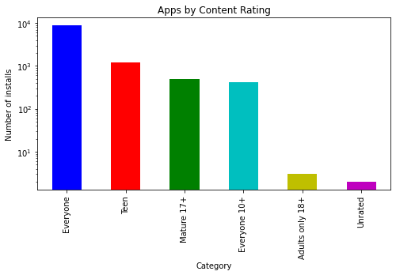
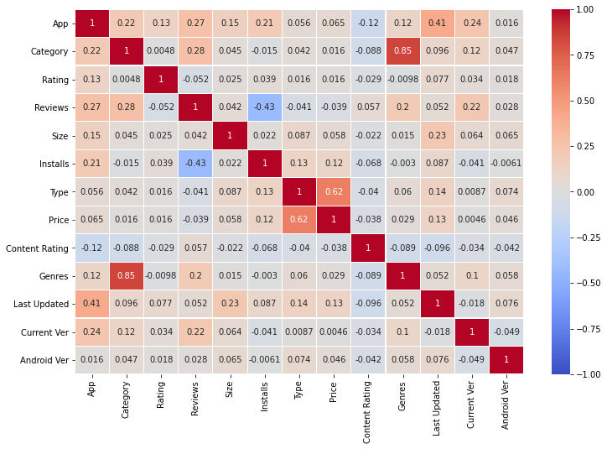

Slide 26
SPLITTING DATASET INTO TRAIN AND TEST DATA
Data splitting is the act of partitioning available data into. two portions, usually for cross validatory purposes.
One. portion of the data is used to develop a predictive model. and the other to evaluate the model's performance.
Separating data into training and testing sets is an important part of evaluating data mining models.
Typically, when you separate a data set into a training set and testing set, most of the data is used for training, and a smaller portion of the data is used for testing.

Slide 27
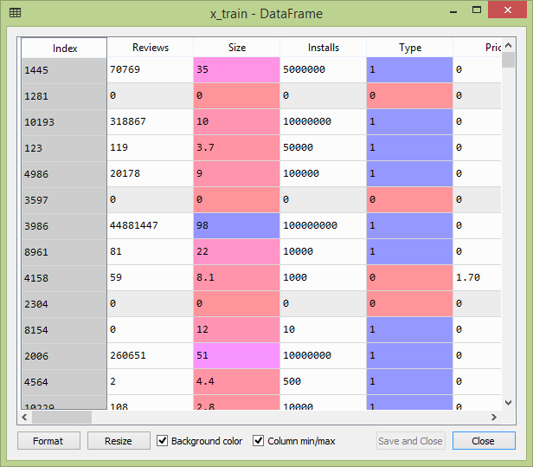
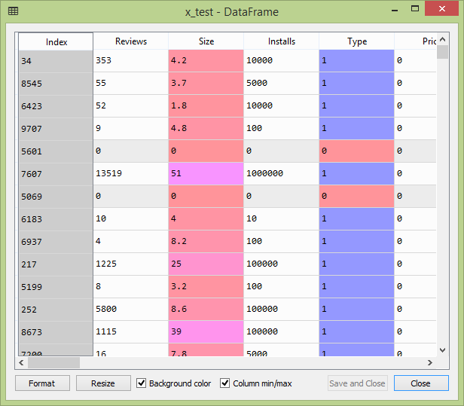

Slide 28
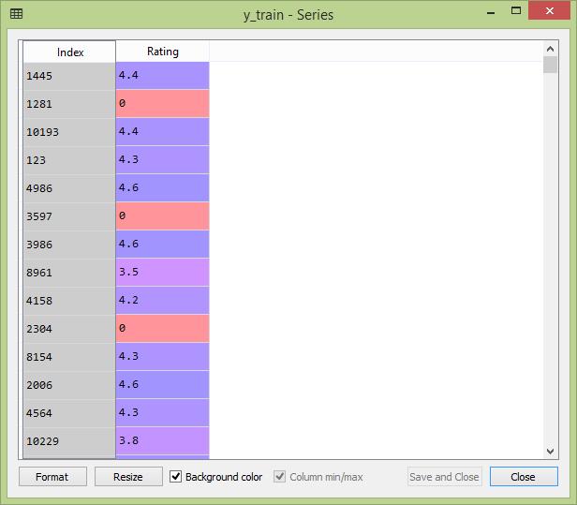
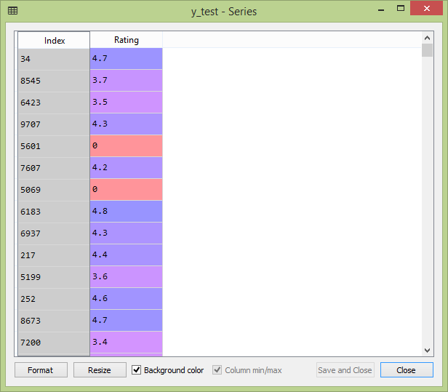

Slide 29
CLASSIFICATION
Classification is a process related to categorization, the process in which ideas and objects are recognized, differentiated, and understood.
In this the ML (KNN and Random Forest) regression algorithm is used for predicting the googleplay app ratings.

Slide 30
PERFORMANCE EVALUATION
The Final Result will get generated based on the overall classification and prediction. The performance of this proposed approach is evaluated using some measures like,
Accuracy
MAE
RMSE
R2-Score

Slide 31
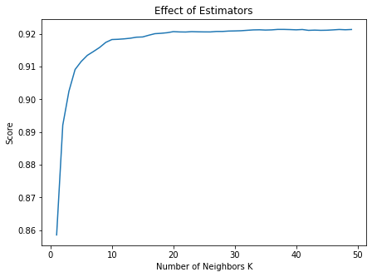
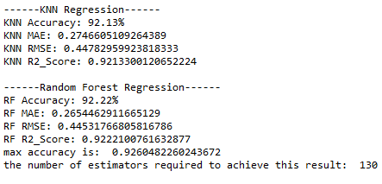
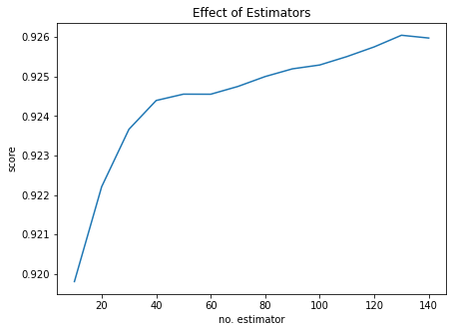

Slide 32
SYSTEM REQUIREMENTS
Software Requirements
Operating System : Windows 7
Language : Python
IDE : Anaconda – Spyder IDE

Slide 33
SYSTEM REQUIREMENTS
Hardware Requirements
Hard Disk : 1000 GB
Monitor : 15 VGA color
Mouse : Microsoft.
Keyboard : 110 keys enhanced
RAM : 4GB

Slide 34
LITERATURE SURVEY

Slide 35
Title | Year | Author | Methodology | Advantages | Disadvantages
Correlation of benign incidental findings seen on whole-body pet-ct with knee mri: patterns of 18f-fdg avidity, intra-articular pathology, and bone marrow edema lesions | 2018 | C. J. Burke, W. R. Walter, S. Gaddam, H. Pham, J. S. Babb, J. Sanger, and F. Ponzo | Objectives To correlate patterns of 18F-FDG uptake on whole-body PET-CT with MR findings and compare the degree of FDG activity between symptomatic and asymptomatic knees. Materials and methods Retrospective database query was performed using codes for knee MRI as well as whole-body PET-CT. | The proposed system improves the overall system performance as well as provides easy scalability. | Less Effective.

Slide 36
Title | Year | Author | Methodology | Advantages | Disadvantages
Introduction to machine learning: k-nearest neighbors | 2016 | Z. Zhang | Machine learning techniques have been widely used in many scientific fields, but its use in medical literature is limited partly because of technical difficulties. k-nearest neighbors (kNN) is a simple method of machine learning. | High performance and accuracy. | It is having some scalability problem.

Slide 37
Title | Year | Author | Methodology | Advantages | Disadvantages
Risk analysis tool for granting credit by financial cooperatives for legal entities | 2020 | Adailton Vieira, Marino Luiz EyerkauferI, Rodrigo Renge | This study aims to elaborate an analysis tool with a broad view of the risks involved in a financial cooperative in granting of credit. The risks in cooperative were analyzed to identify current tools of credit analysis; to verify the efficiency of these, the risk mutations and their impacts during different periods. | More Reliable. | It is less in efficiency and not give perfect result.

Slide 38
Title | Year | Author | Methodology | Advantages | Disadvantages
Classifiers Comparison for Attack Detection in Computer Networks | 2017 | K. R. Santos, I. R. R. Silva, and R. A. A. Fagundes | With the advancement of information technology and the consequent growth of information trafficked the computer network attacks and anomalies in this environment it has become increasingly common in recent decades, causing many researchers were concerned with the identification of these attacks. | High Efficiency. | Low in accuracy performance.

Slide 39
Title | Year | Author | Methodology | Advantages | Disadvantages
Numeric rating of Apps on Google Play Store by sentiment analysis on user reviews | 2014 | M. R. Islam | The sudden eruption of sentiment analysis and opinion mining has opened new possibilities to improve our information gathering interests. We are always keen to know what others say about the devices or applications we are going to use. | Good in Performance. | Not Reliable

Slide 40
CONCLUSION
From the analysis, these algorithms and process, we concluded that our hypothesis is true. Meaning you can predict the app ratings, however significant preprocessing must be done before you start the classification and regression processes.
The Play Store apps data has enormous potential to drive app-making businesses to success. Actionable insights can be drawn for developers to work on and capture the Android market!
This shows that given the Size, Type, Price, Content Rating, and Genre of an app, we can predict accuracy if an app will have more than 100,000 installs and be a hit on the Google Play Store.

Slide 41
FUTURE ENHANCEMENT
In the future, includes the implementation of the deep learning technique to predict numeric rating.

Slide 42
PROBLEM STATEMENT
We have taken the dataset and observed it nicely and as per our need we have taken various attributes to analyze and further display the result.
By doing this, we can clearly and easily observe the dataset.
Moreover, Firstly, I will analyze different attributes given in dataset.
Secondly, I will do prediction of those different attributes like predict whether the user review is positive or negative.

Slide 43
REFERENCES
[1] C. J. Burke, W. R. Walter, S. Gaddam, H. Pham, J. S. Babb, J. Sanger, and F. Ponzo, “Correlation of benign incidental findings seen on whole-body pet-ct with knee mri: patterns of 18f-fdg avidity, intra-articular pathology, and bone marrow edema lesions,” Skeletal Radiology, vol. 47, no. 12, pp. 1651–1660, Dec 2018.
[2] Z. Zhang, “Introduction to machine learning: k-nearest neighbors,” Annals of translational medicine, vol. 4, no. 11, 2016.
[3] Adailton Vieira , Marino Luiz EyerkauferI, Rodrigo Renge, “Risk analysis tool for granting credit by financial cooperatives for legal entities,” ˜ RGC, Santa Maria, v. 7, n. 13, Jan./Jun., 2020.
[4] K. R. Santos, I. R. R. Silva, and R. A. A. Fagundes, “Classifiers comparison for attack detection in computer networks,” IEEE Latin America Transactions, vol. 15, no. 1, pp. 87–96, 2017.
[5] M. R. Islam, “Numeric rating of apps on google play store by sentiment analysis on user reviews,” in 2014 International Conference on Electrical Engineering and Information & Communication Technology. IEEE, apr 2014.

Slide 44
REFERENCES
[6] N. Mohd Nawi, W. Atomi, and S. M. Rehman Gillani, “The effect of data pre-processing on optimized training of artificial neural networks,” vol. 11, 06 2013.
[7] F. Pedregosa, G. Varoquaux, A. Gramfort, V. Michel, B. Thirion, O. Grisel, M. Blondel, P. Prettenhofer, R. Weiss, V. Dubourg, J. Vanderplas, A. Passos, D. Cournapeau, M. Brucher, M. Perrot, and E. Duchesnay, “Scikit-learn: Machine learning in Python,” Journal of Machine Learning Research, vol. 12, pp. 2825–2830, 2011.

Slide 45
Thank You…

